Slide 1
Group 3 - Final Project

Slide 2
Management of the project
Scrum Master and Dev-Ops Manager: Zonaira
Front-end Manager: Luke
Back-end Manager: Dylan
Front-end assistant, and Documentation: Thomas
These were roles given but due to the nature of the project and size of the team we all helped each other out and got involved in each part.

Slide 3
Rolling Updates
Implementing a rolling update

Slide 4
New tools Learned
React
Spring Micro services
Jest

Slide 5
React
Open-source
Created and maintained by Facebook
Painless delivery of interactive UIs
Localised rendering of components
Render on the server using Node

Slide 6
Spring Micro Services
Breaking a traditionally monolithic style spring boot program into separate modules
Advantages in large-scale architecture including:
scalability
fault isolation and resilience
Programming language flexibility
Improved data security
When updating 1 feature you only need to redeploy 1 service rather than the whole application.

Slide 7
Jest
“A JavaScript Testing Framework with a focus on simplicity” – QA Community
Minimal Configuration
Snapshots
Isolated
Fast
Coverage
Easy Mocking

Slide 8
The Brief
This was a Group Project to fully develop an application and deploy it.
We had 2 weeks to create the program, pipeline and all accompanying documentation
Development of a Spring Boot Help Queue with full CRUD functionality for practical use as a training aid in the Academy.
Expected to implement Basic Functionality and at least two additional features.

Slide 9
Incorporation of new tools
We used React and Jest for the front-end
Spring Boot microservices for the back-end

Slide 10
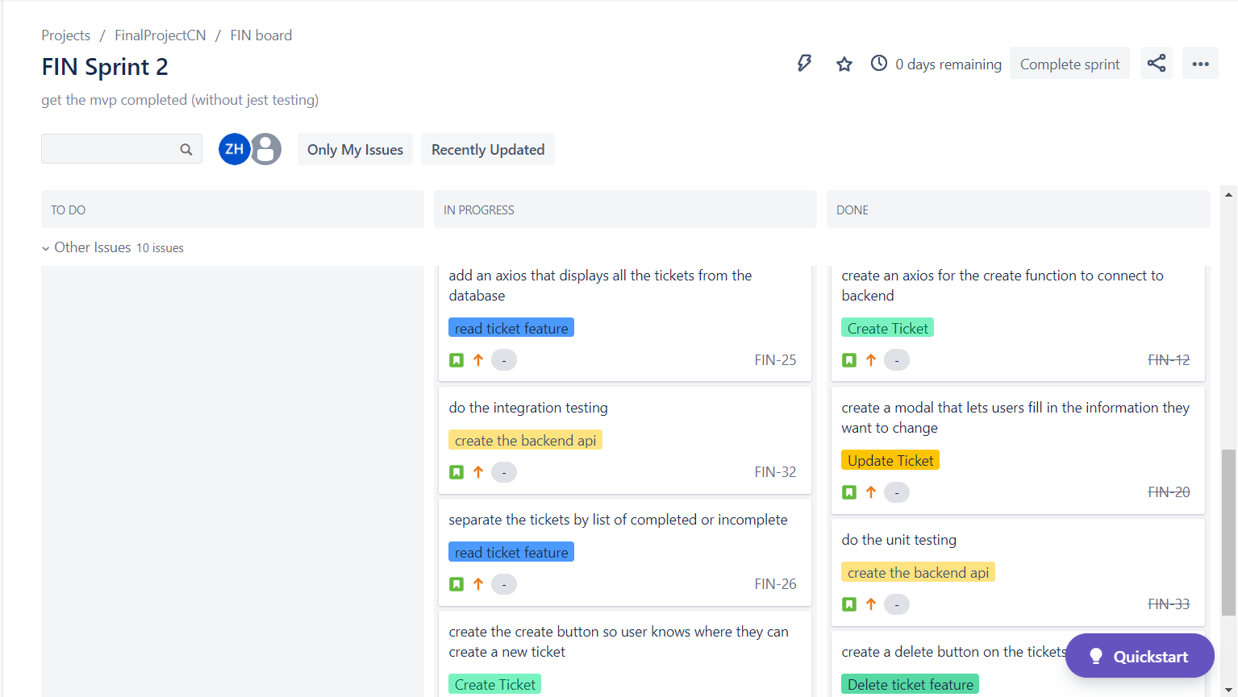
Jira Board
In progress sprint
With stories from separate epics

Slide 11
Priorities for the Front-end
Functionality
Design simplicity
Intuitive operation

Slide 12
Priorities for Back-End
Utilising Microservices
Seamless CRUD functionality
High test coverage

Slide 13
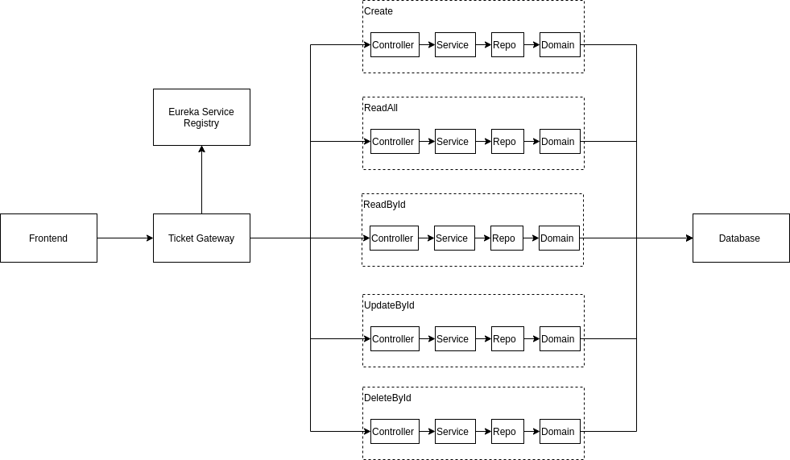
Microservice Structure
A separate service for each available fetch request
Full CRUD utilization
Eureka directs the fetch requests and load balances services

Slide 14
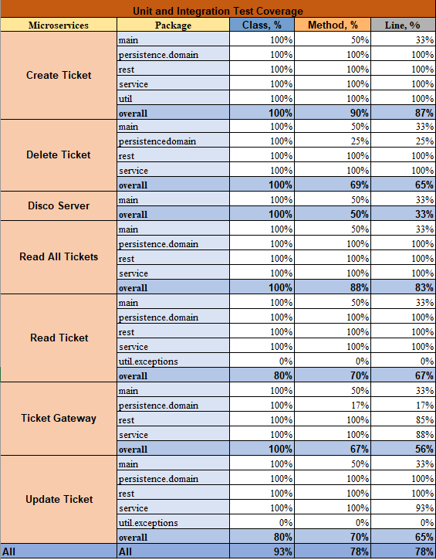
Spring Boot testing
High Test coverage
Each service needed to test every component

Slide 15
Priorities for Dev-ops
Smooth deployment
Test running
Provisioning and allocation of resources

Slide 16
What we learnt
Microservices require separate pipelines.

Slide 17
How to improve next time
Ticket gateway is single point of failure, fix: apply round robin load balancing

Slide 18

Demo

Slide 19

Q&A
Any questions for the team?

